Slide 1
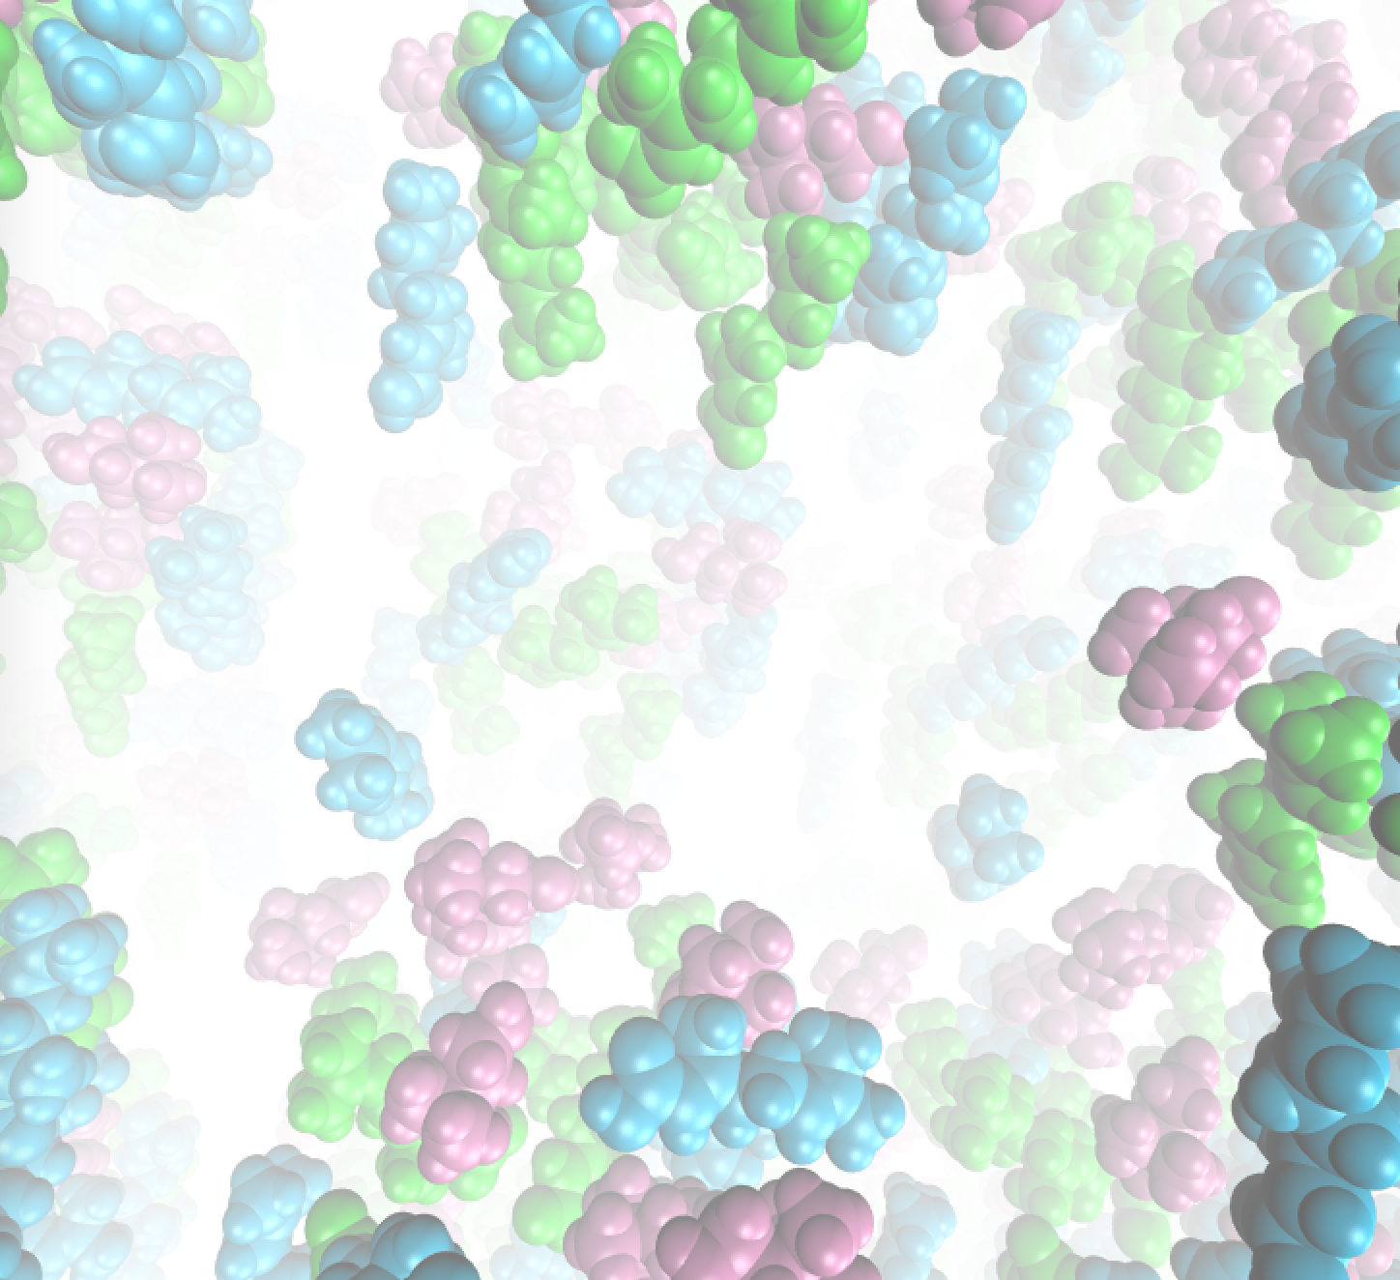

Surviving space travel: Solvent-mediated preservation of diabetes medicine
Kyle S. Ghaby¹, Joseph Baker²,
and Gerrick E. Lindberg¹
1. Department of Chemistry and Biochemistry, Northern Arizona University, Flagstaff, AZ
2. Department of Chemistry, The College of New Jersey, Ewing, NJ
Contact: ksg225@nau.edu
Notes:
The first steps in developing temperature resistant insulin storage

Slide 2
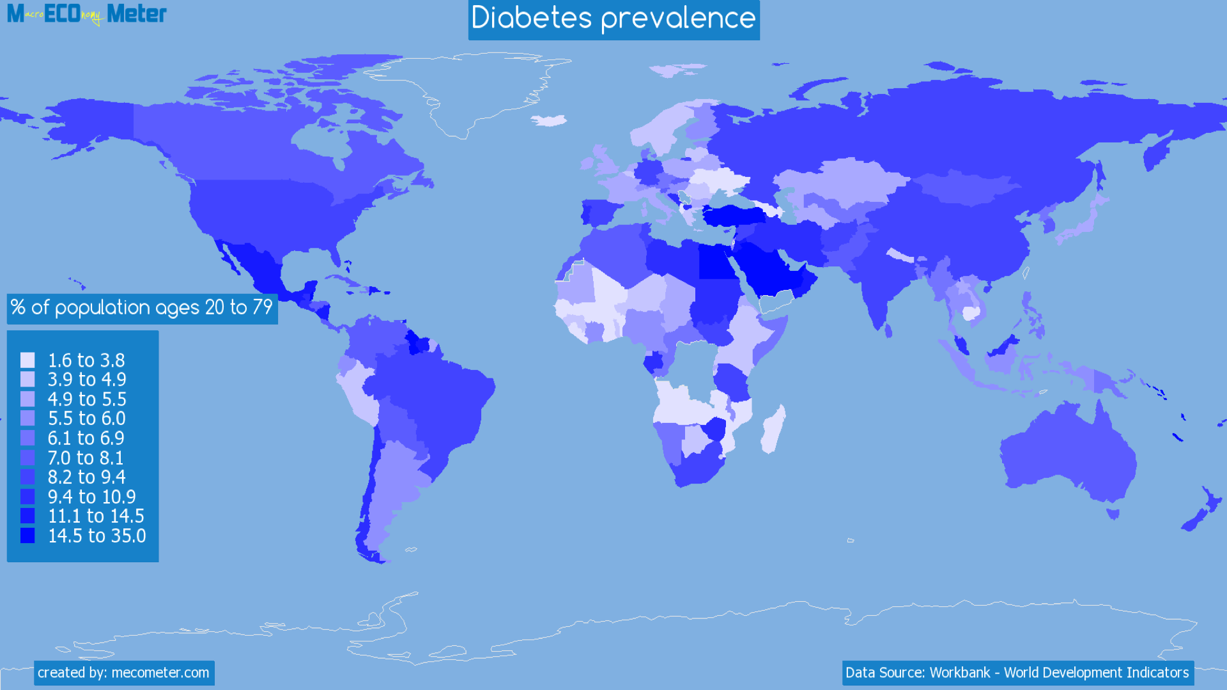
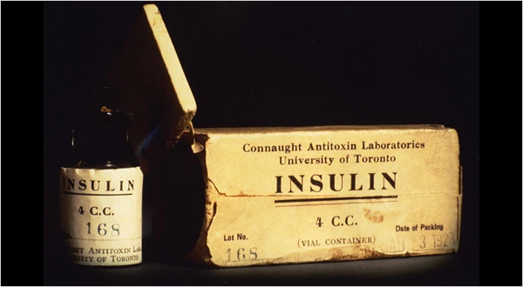
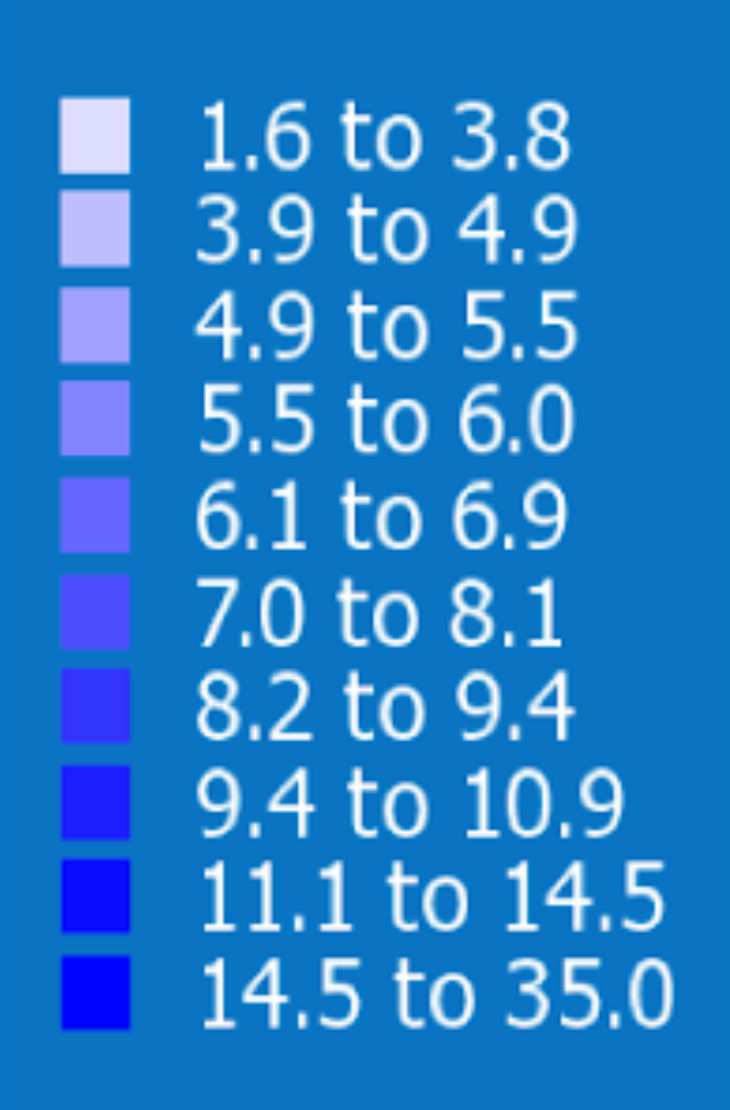
Temperature-stable insulin is long overdue
Many people with diabetes lack electricity
They cannot refrigerate insulin
The shelf life of insulin is significantly curbed
Medicinal insulin is ~100 years old, yet universal storage has not been found!
Notes:
Ubiquitous at high rates. No 0 on the scale
Lots of areas that can’t preserve their insulin, so we need a way to give those people insulin at room temp
Navajo has 20-30% diabetes and pima has 50%. About 32% of navajo homes lack electricity!
Cheaper bc people dont have to buy uninsured insulin and also because longer shelf life.

Slide 3
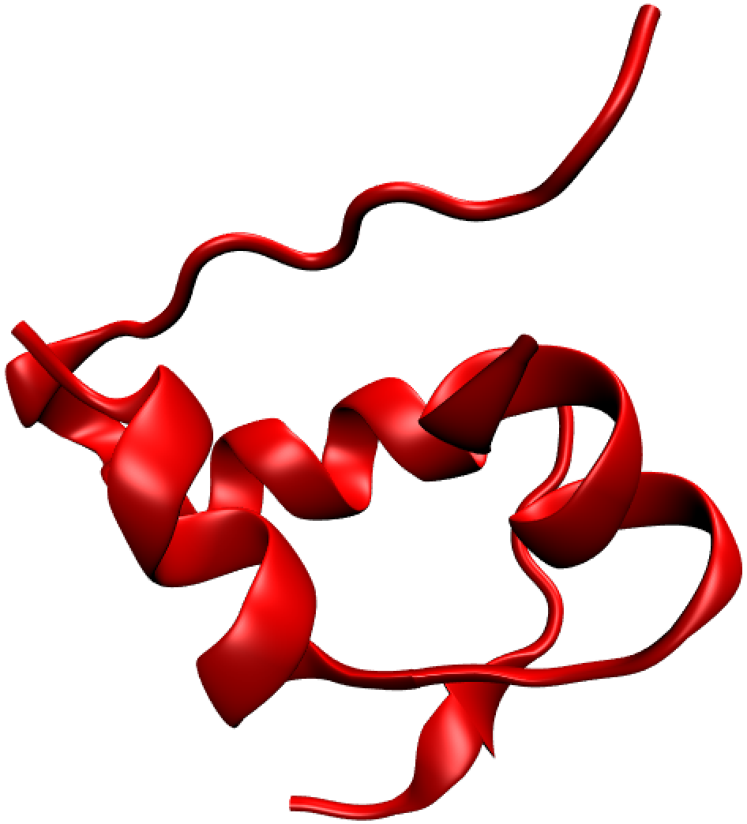
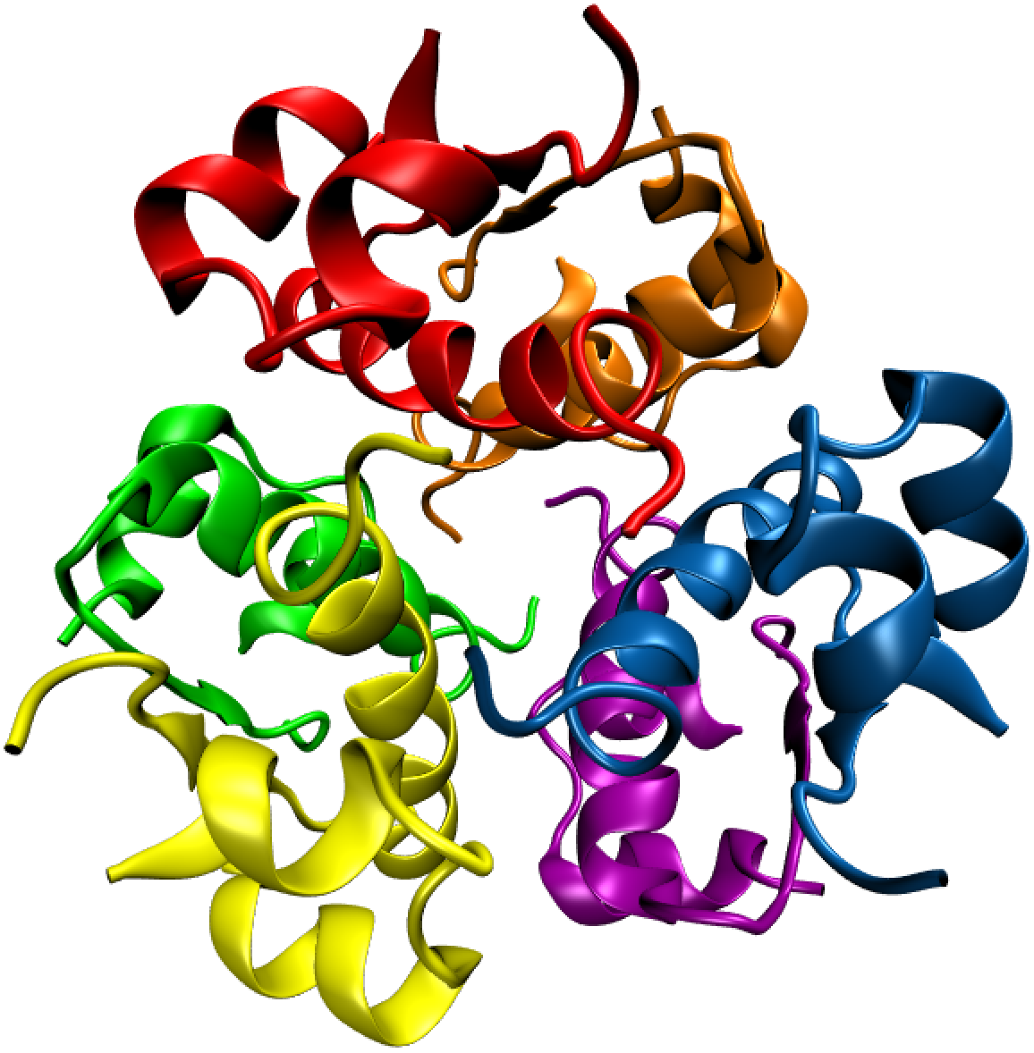
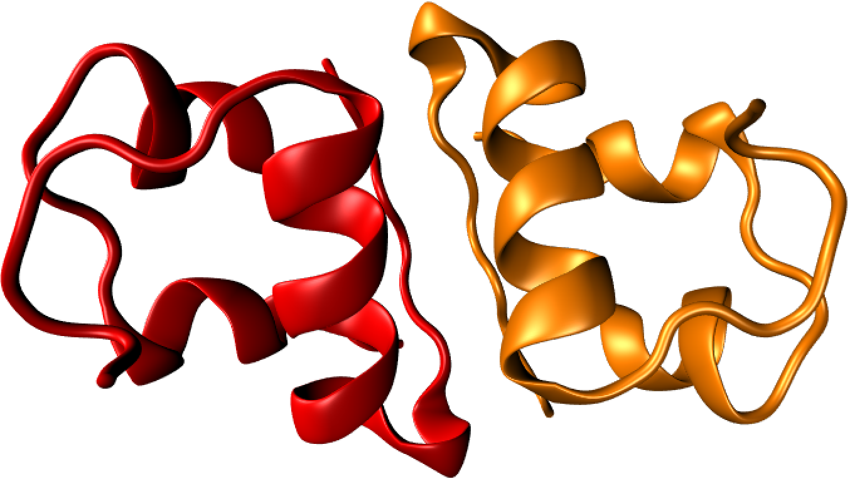
Insulin can form ordered aggregates; a blessing and a curse.
Hexamer
Monomer
Dimer
Dunn, M. F. Biometals 2005
Notes:
Monomeric insulin naturally aggregates into a hexamer made of three dimer intermediates.
Hard to stop this regardless of international years of effort bc its evolutionarily designed to aggregate so its not degraded during pancreatic storage.

Slide 4
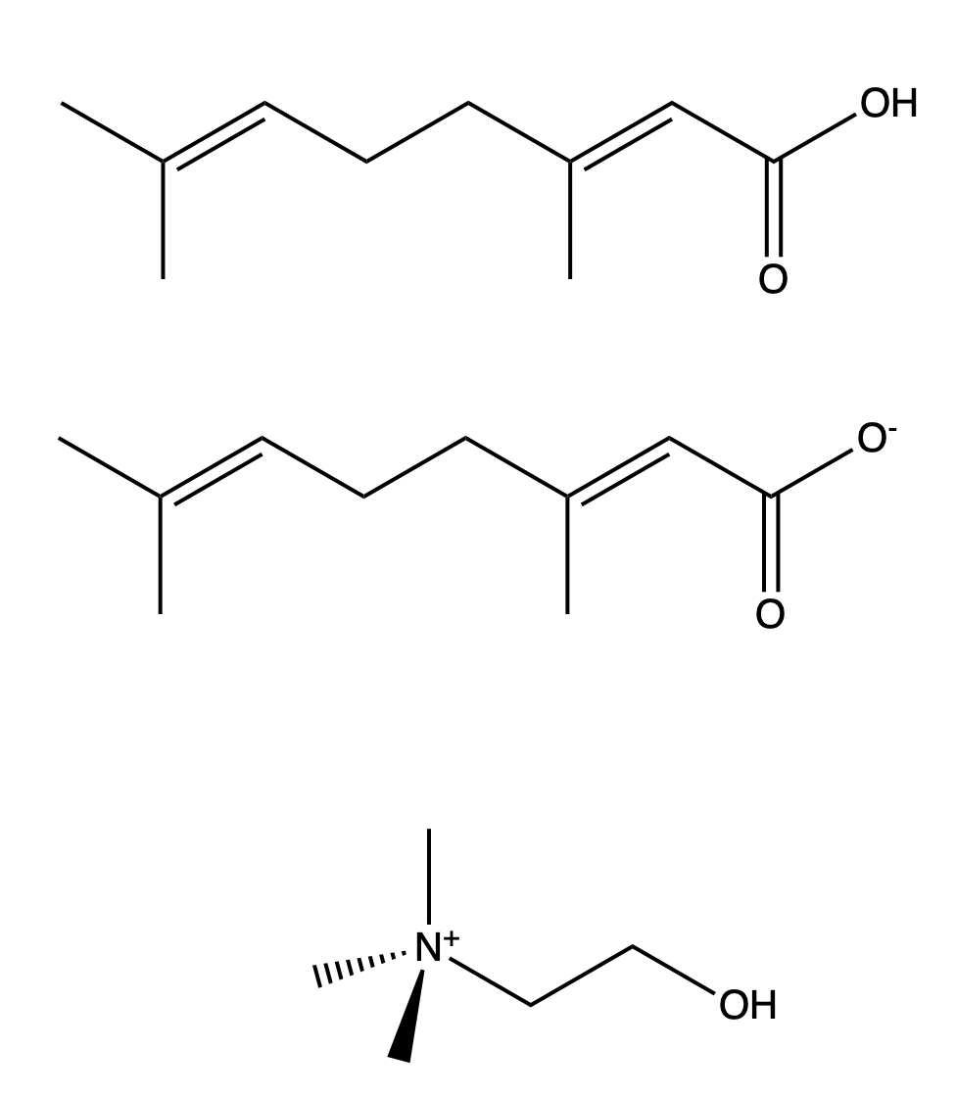
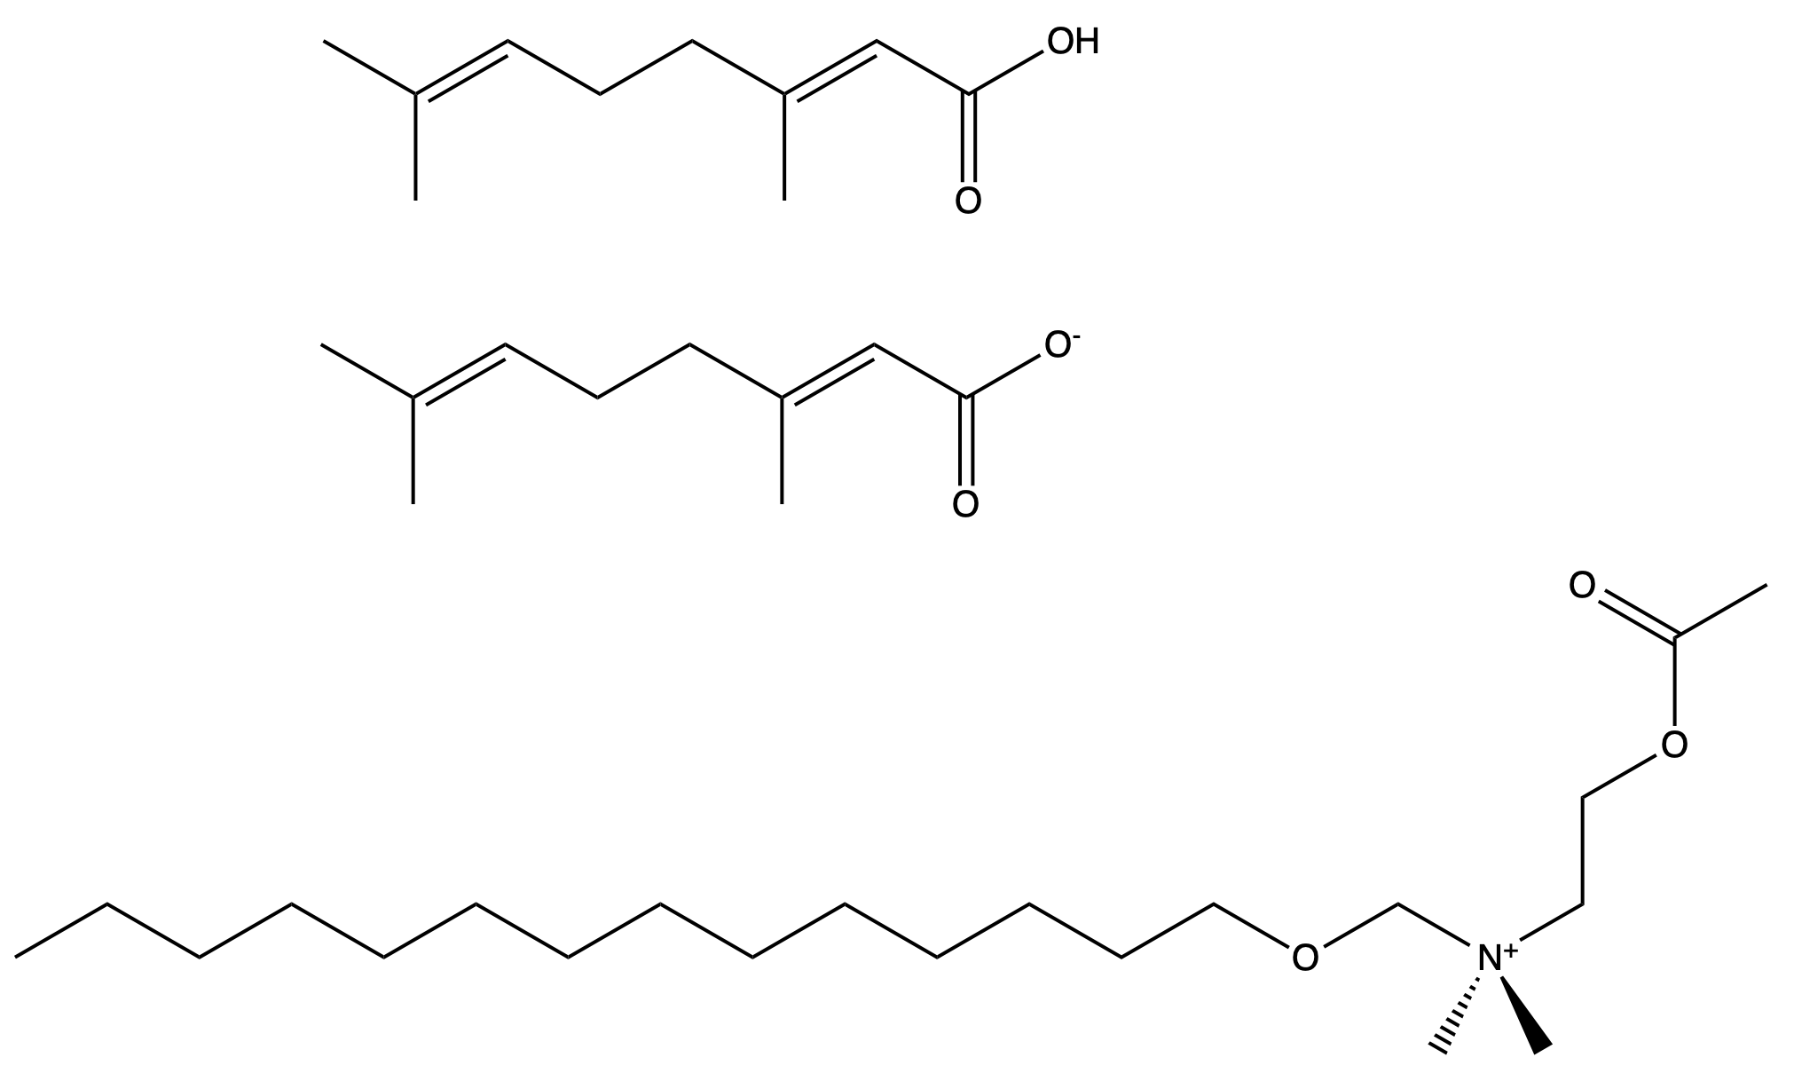
Our approach: Preserving insulin with ionic liquids (ILs)
Nine More Ionic Liquids
1. CAGE
2. mCAGE
Modified choline
Notes:
Cage was chosen because it has been shown to induce helices in protein, thus it was a good candidate for keeping it stable at high temps. Low vapor pressure and antibacterial properties. Also biocompatible.
mCAGE was developed by a collaborator to potentially pronounce CAGE’s properties.

Slide 5
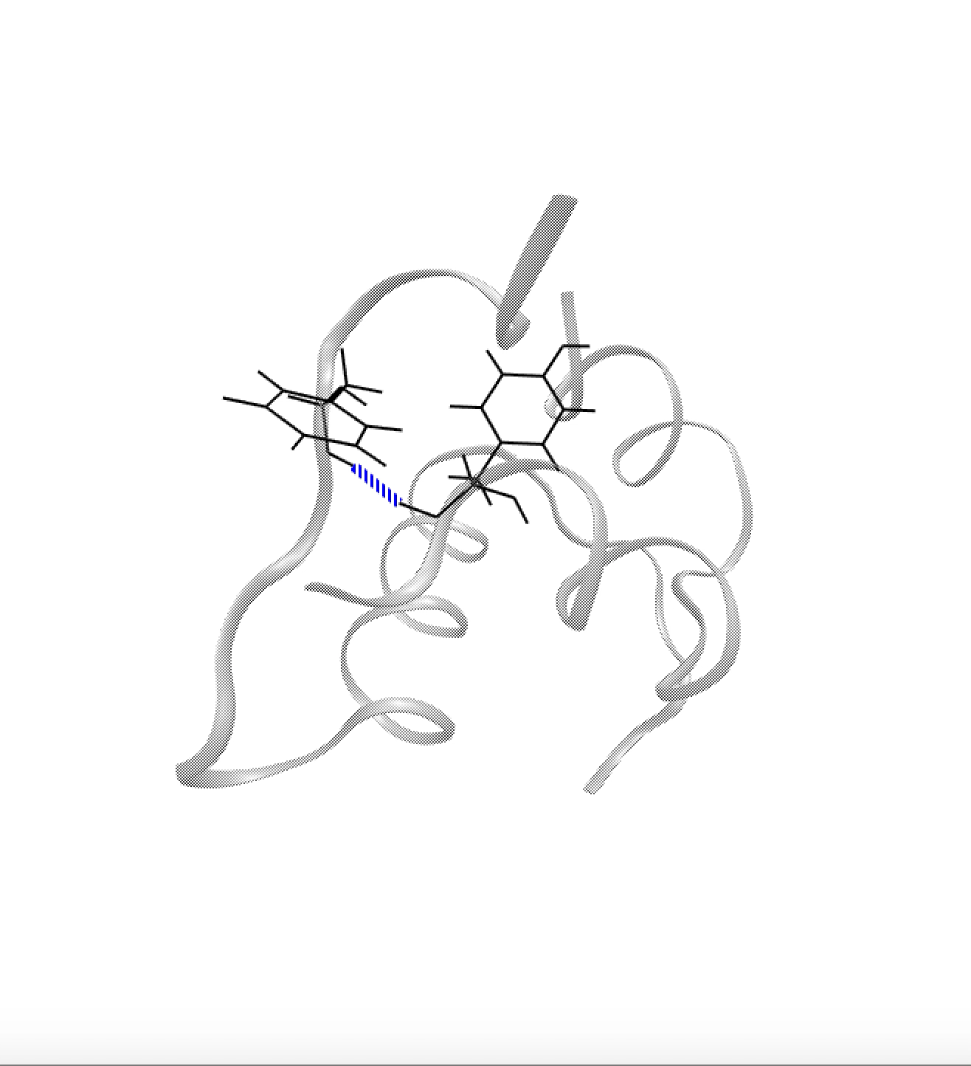
Classical all-atom molecular dynamics (MD) simulations for the investigation of molecular details
Initialize and parameterize system
Calculate the force on each atom
Calculate the acceleration of each atom
Propagate each atom for 1-2 fs
Repeat
Notes:
Talk about why in silico
Cost
Efficiency
Most important: molecular interactions
Accuracy of this method can be verified by a hbond that is well described in the literature. Matches experimental outcomes

Slide 6
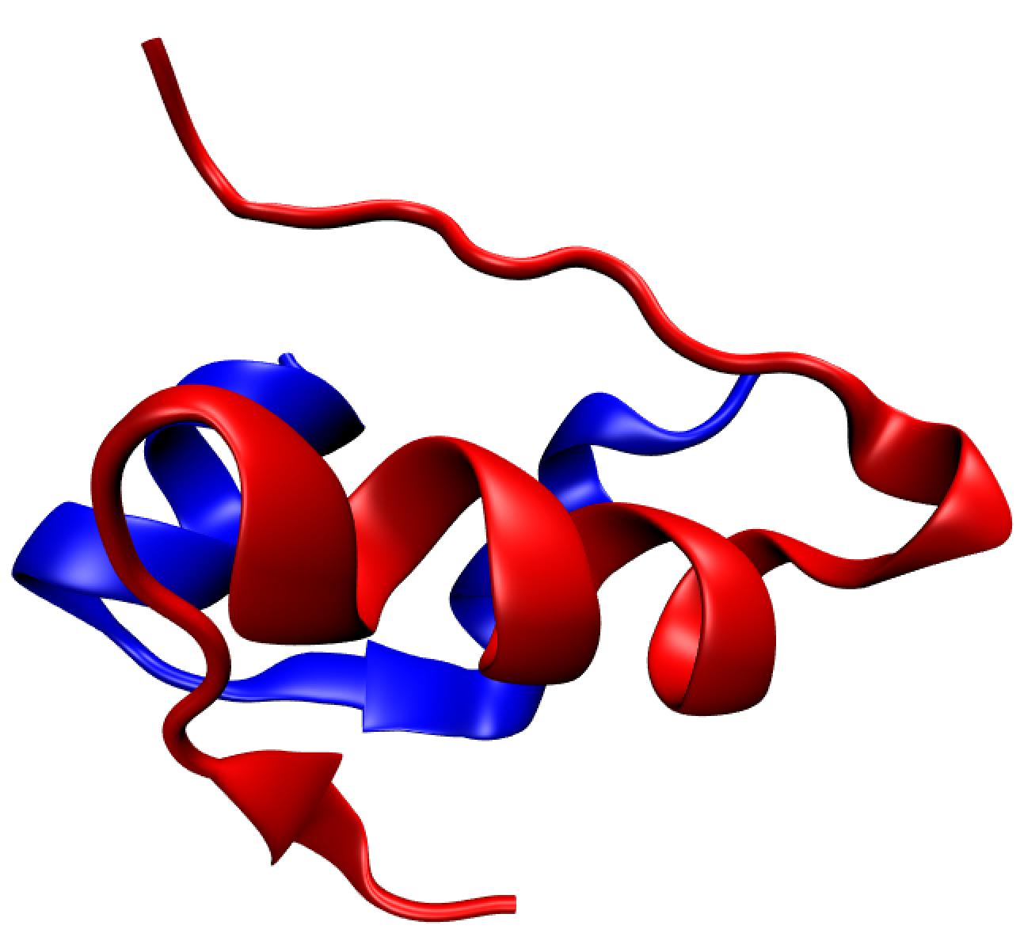
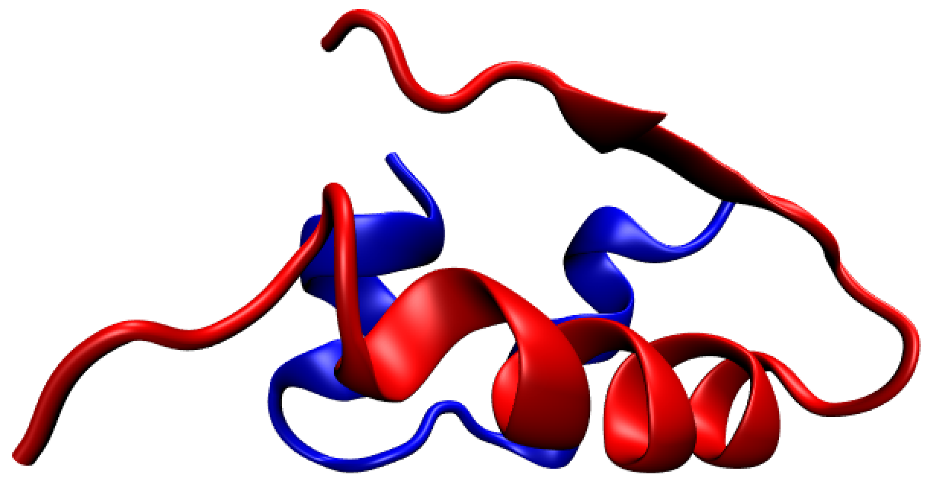
Note, insulin is conformationally impressionable
An insulin monomer
A monomer from a hexamer
Notes:
Structure changes in b chain from S to C. Maintaining structure is important. We need structural integrity.
Changes in native structure are necessary for dimer- and hexamerization.

Slide 7
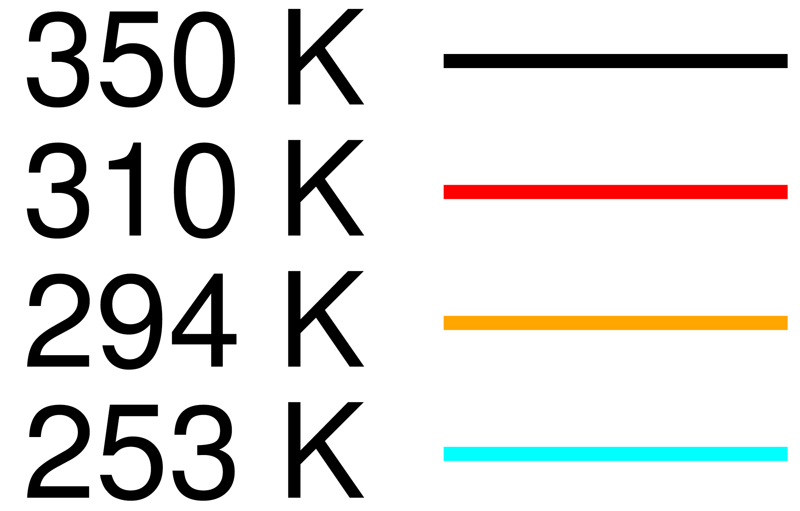
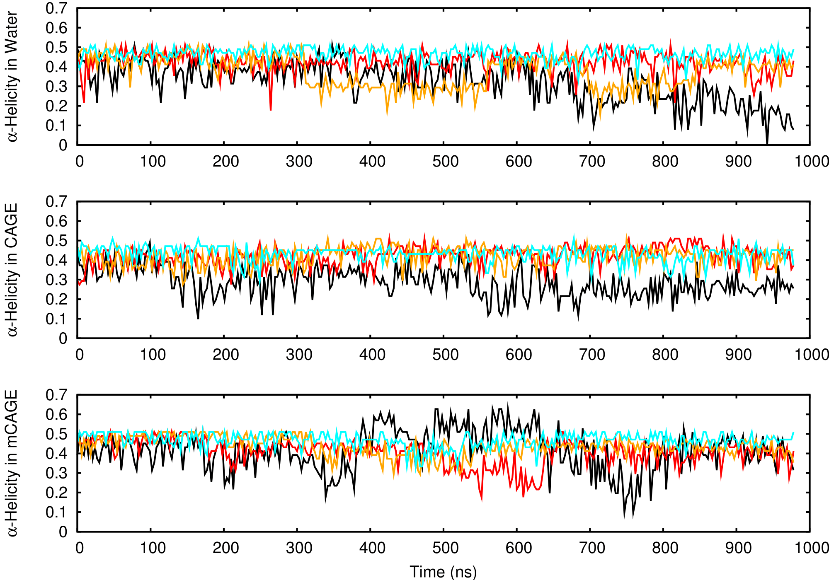
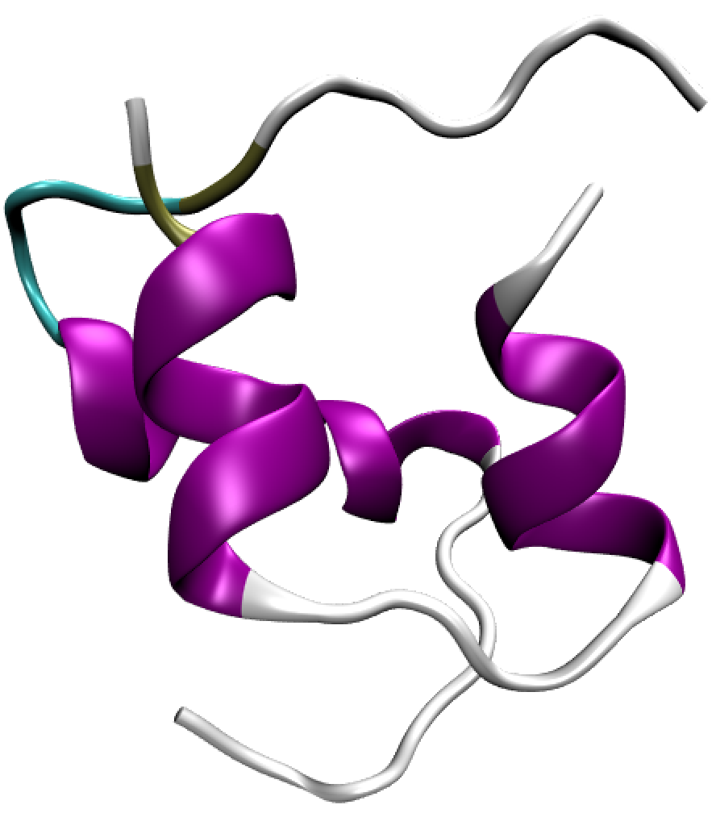
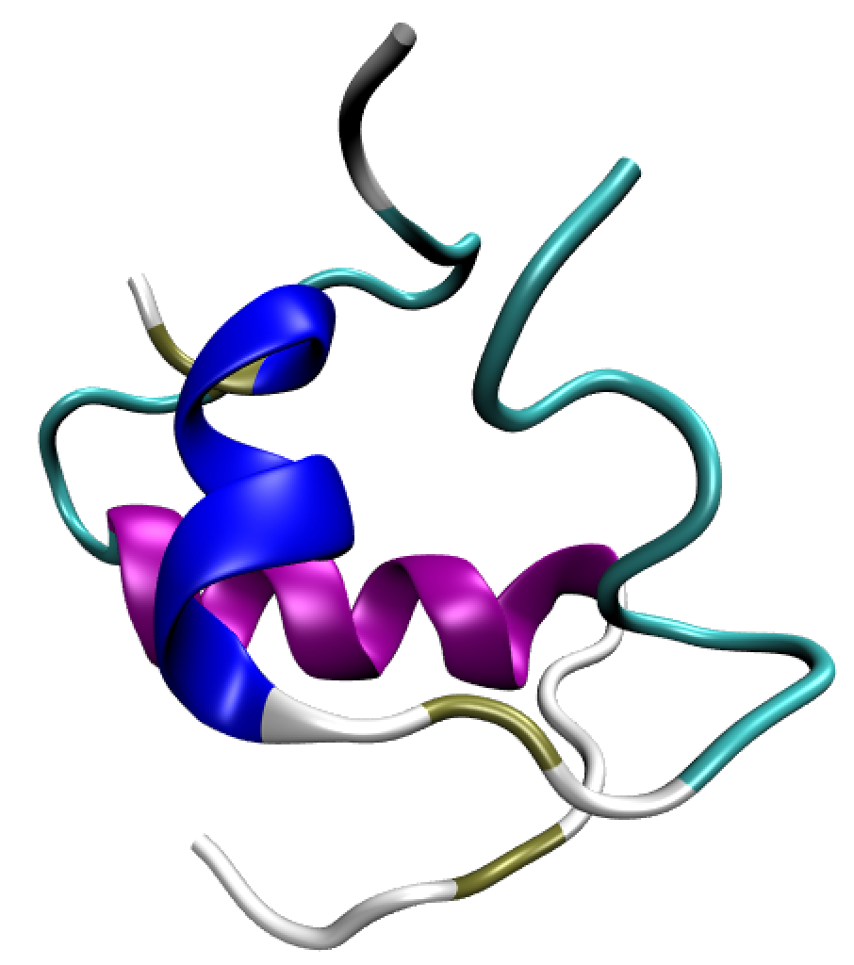
ɑ-helicity was conserved over time and temperature in ILs
In water @ 294 K
Normal ɑ-helicity
Low ɑ-helicity
Notes:
Total helicity is the addition of alpha and 3-10

Slide 8
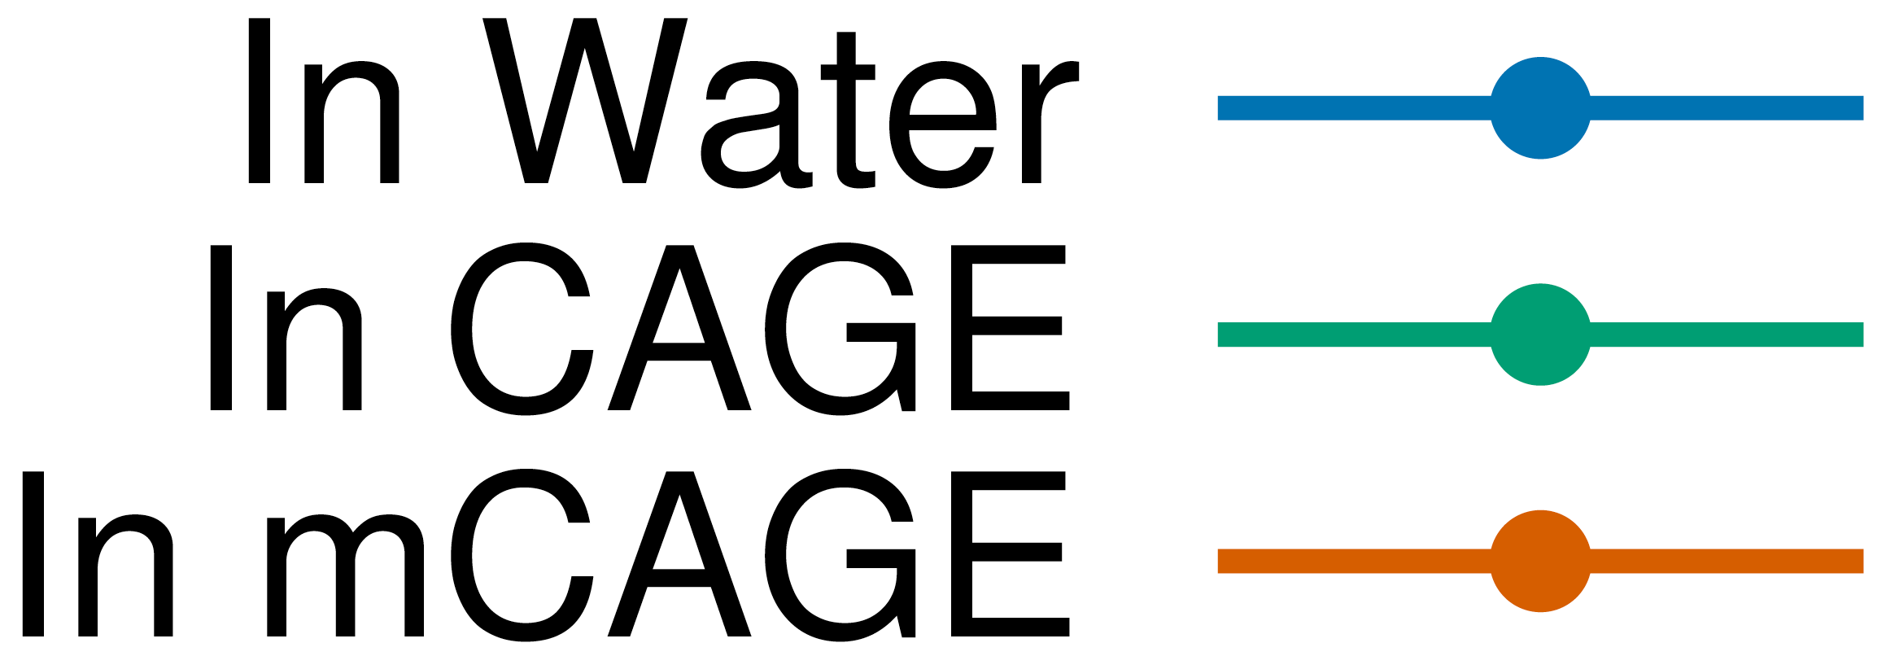
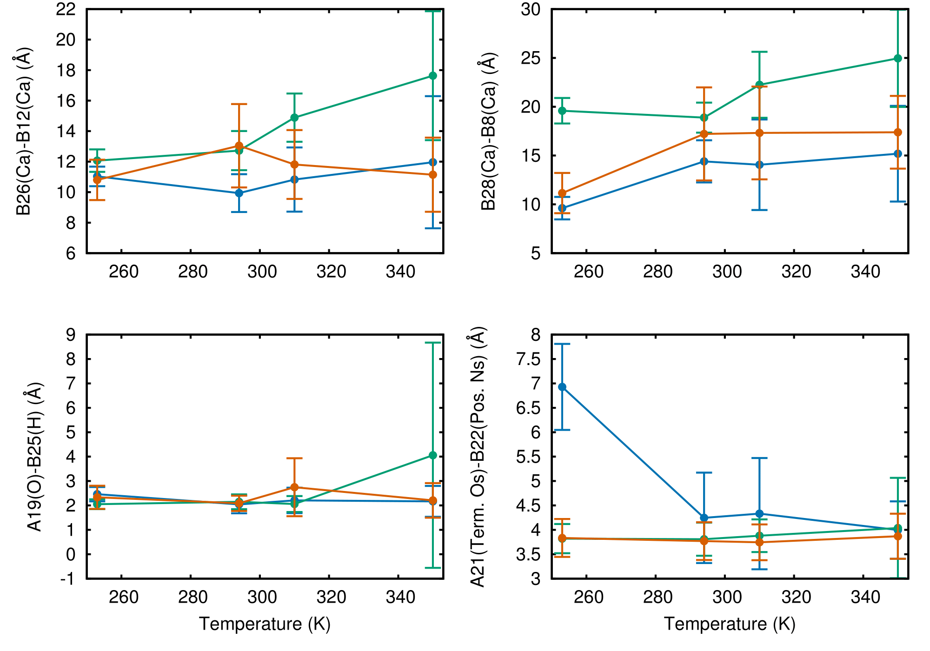
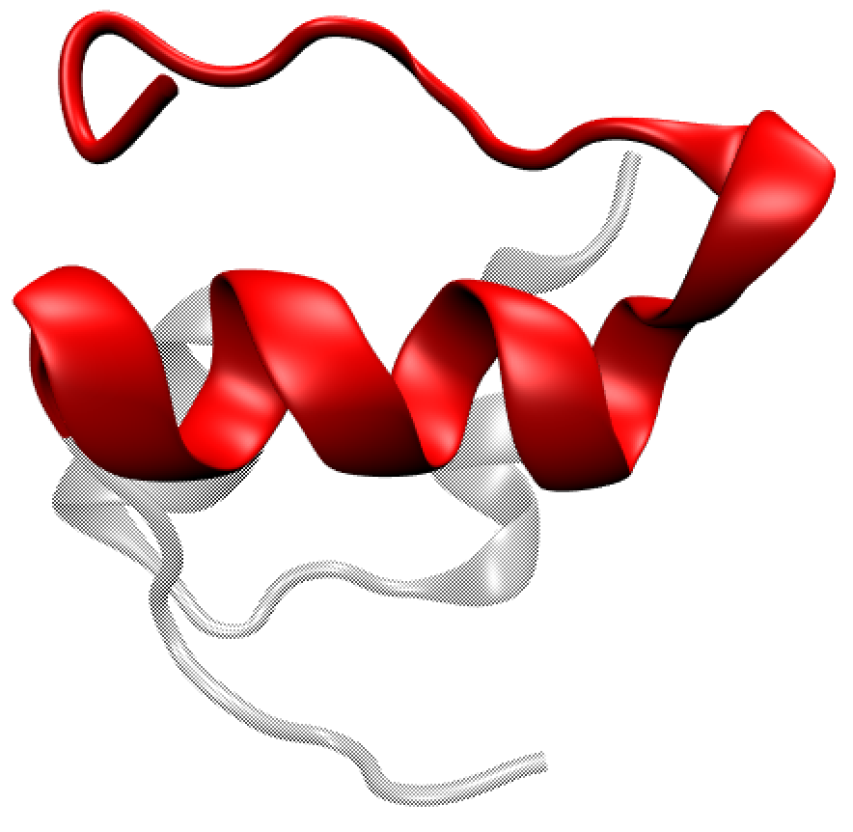
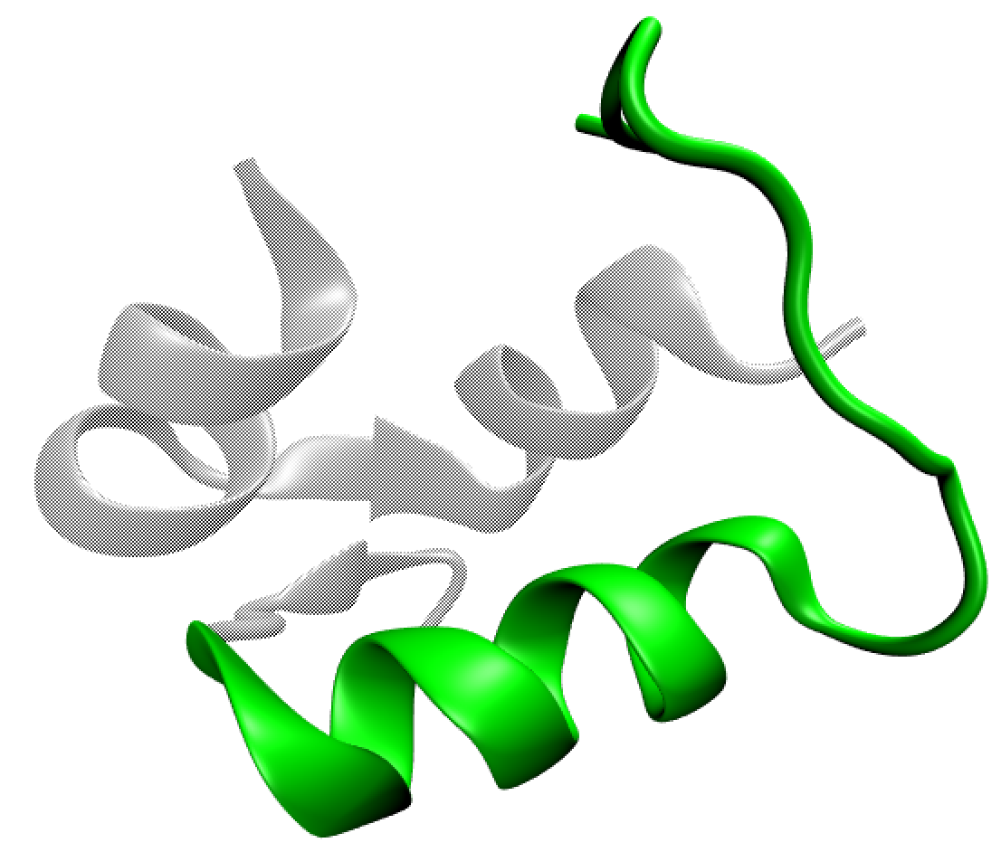
In ILs, insulin was “active,” and some intramolecular associations were promoted/demoted
In water @ 294 K
“Inactive”
In CAGE @ 294 K
“Active”
Notes:
Total helicity is the addition of alpha and 3-10

Slide 9
Conclusions
Structural changes that precede aggregation may be prevented in CAGE and mCAGE

Slide 10
Conclusions
Structural changes that precede aggregation may be prevented in CAGE and mCAGE
CAGE and mCAGE promoted insulin activity and intramolecular ionic interactions

Slide 11
Conclusions
Structural changes that precede aggregation may be prevented in CAGE and mCAGE
CAGE and mCAGE promoted insulin activity and intramolecular ionic interactions
The structural influence of these ILs may create a temperature-stable environment that prolongs insulin shelf-life…on Earth and in space!

Slide 12





Acknowledgments
Contact: ksg225@nau.edu
Danielle Jacobs at
Rider University
Lindberg Research Group at Northern Arizona University
Notes:
Thank you to funding sources, monsoon, and lindberg lab

Slide 13
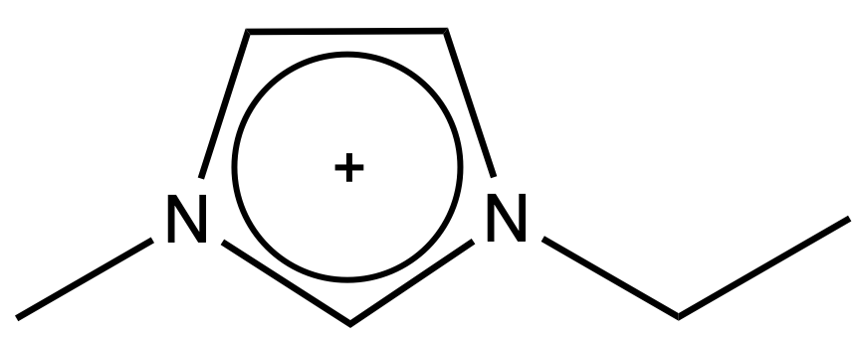
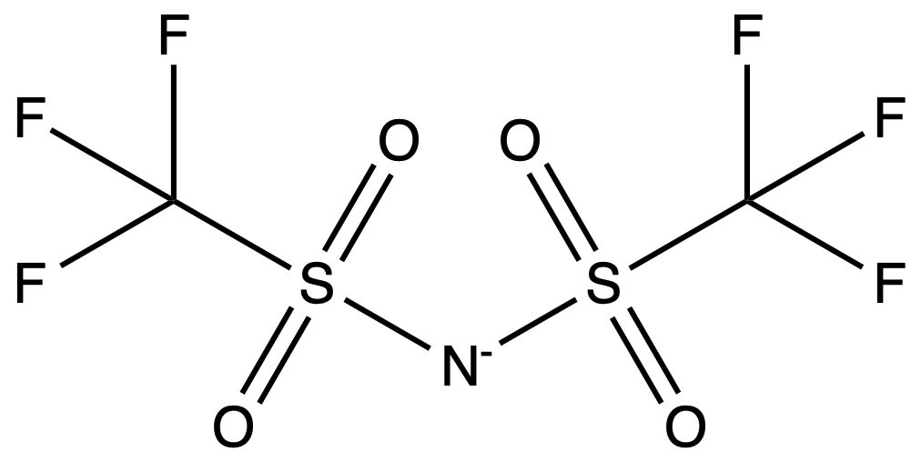
Our approach: Preserving insulin with ionic liquids (ILs)
Nine More Ionic Liquids
1. CAGE
3. [EMIM⁺][TF₂N⁻]
4. [EMIM⁺][Cl⁻]
Cl⁻
2. mCAGE
5. [K⁺][TF₂N⁻]
Modified choline
K⁺
6. [K⁺][Cl⁻]
K⁺
Cl⁻

Slide 14
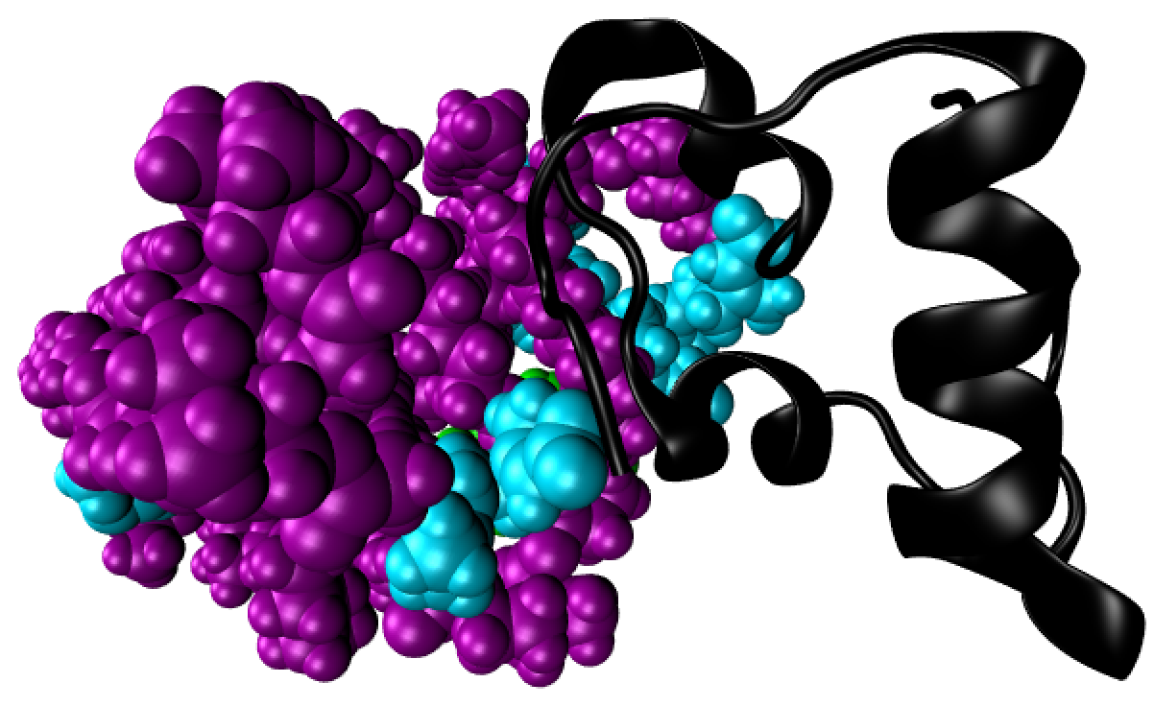
We observed large clusters of mCAGE bound to insulin
Notes:
Another thing we noticed…
Switching gears from insulin structure to IL localization
Does it bind somewhere that matters? Does this happen to all ILs at all temperatures?

Slide 15
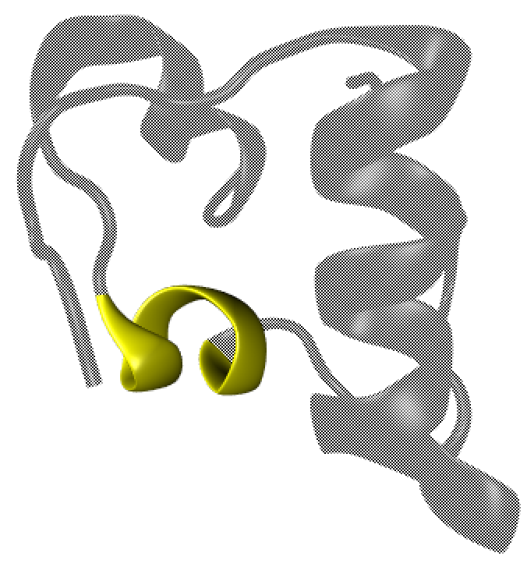
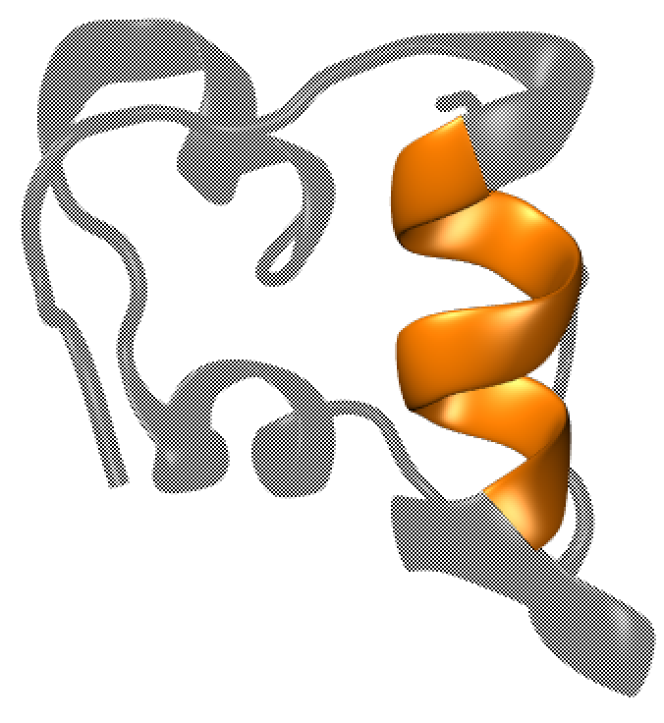
Self-recognition elements (SREs) are useful reference points for radial distribution functions (RDFs)
A-Chain SRE (SRE-A)
B-Chain SRE (SRE-B)
10 angstroms (A)
Asthana, S.; et al. BBA. 2019
Notes:
Conveniently, both sides of insulin have SREs which modulates aggregation. So I calculated the probability of finding the IL at distances around SREs

Slide 16
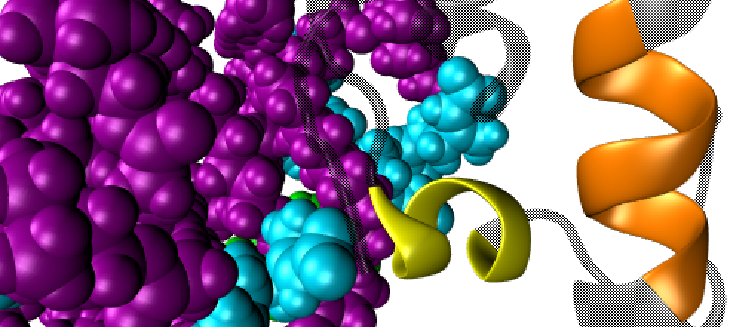

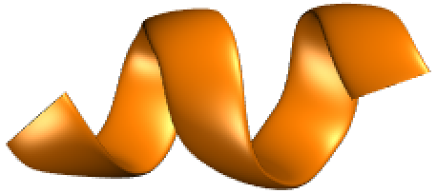
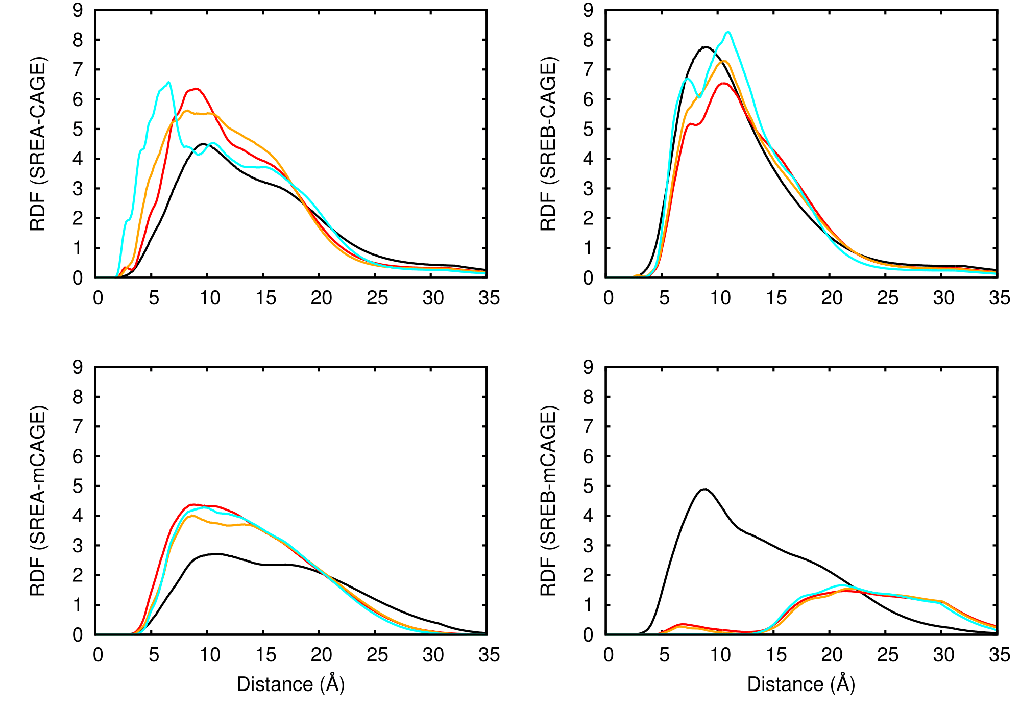
RDFs showed mCAGE clustered on one side of insulin
0 A
20 A
SRE-A
SRE-B
Notes:
Srea shows localization of mCAGE below 350K. SreB shows that it is stuck to Srea but then it dissociates at higher temps and can float around the Sreb

Slide 17
RDFs showed CAGE is localized to both sides of insulin
SRE-A
SRE-B
Notes:
RDF max is 5-10 Angstroms every time CAGE is localized around both sres (ie sides of insulin) so it doesnt stick, it just floats closely it seems
In both instances, the ILs were localized to sres and may sterically inhibit aggregation

